Slide 1
Capstone Project
Face Emotion Recognition Deep learning and MLE
SHASHANK BHATIA

Slide 2
CONTENTS
Problem Statement
Data Pipeline
Data Summary
EDA
Data preprocessing
CNN Model
Model Parameters
Model Evaluation
Model Testing
Model Demonstration
Challenges
Conclusion

Slide 3
Problem Statement
The Indian education landscape has been undergoing rapid changes for the past 10 years owing to
the advancement of web-based learning services, specifically, eLearning platforms
Digital classrooms are conducted via video telephony software program (eg Zoom) where it’s not possible for medium scale class (25-50) to see all students and assess the mood. Because of this drawback, students are not focusing on content due to lack of surveillance
We will solve the above-mentioned challenge by applying deep learning algorithms to live video data.
The solution to this problem is by recognizing facial emotions in real time.

Slide 4
DATA PIPELINE
EDA
Image Preprocessing
Model Definition
Model compilation and training
Model testing
Use saved model to create application
conclusion

Slide 5
Data Summary
Data set - FER 2013 dataset
Emotion classes – 7 - ['angry', 'disgust', 'fear', 'happy', 'neutral', 'sad', 'surprise’]
Total images – Training set = 30528
Test Set = 7232

Slide 6
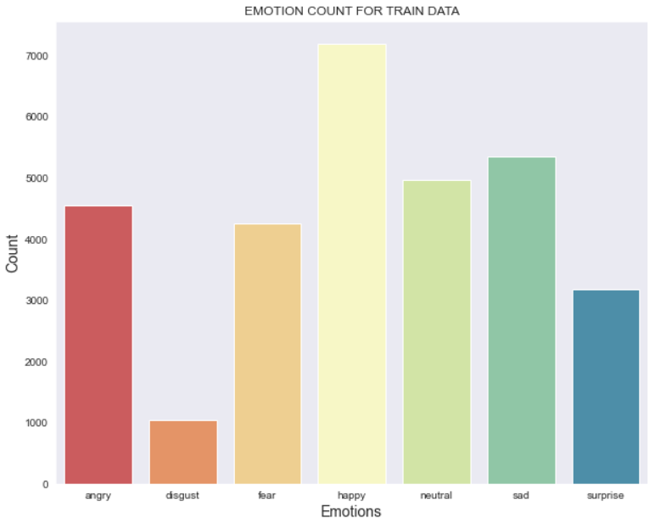
EDA
EMOTION COUNT FOR TRAIN DATA

Slide 7
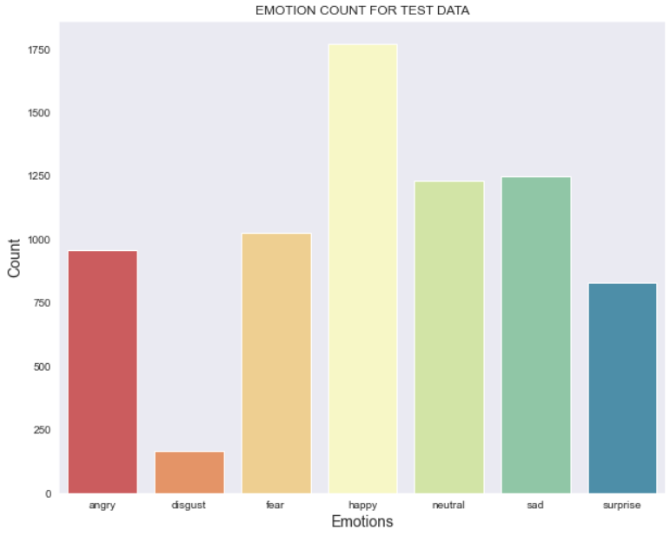
EMOTION COUNT FOR TEST DATA

Slide 8
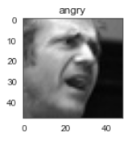
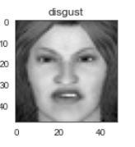
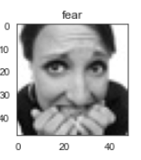
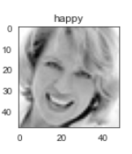
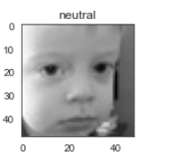
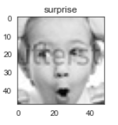
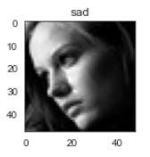
SAMPLE IMAGES UNDER FOR EMOTION

Slide 9
IMAGE PREPROCESSING
Pre-processing the input image data to convert it into meaningful floating-point tensors for feeding into Convolutional Neural Networks.
tensors are used to store data, they can be assumed as multidimensional arrays.
When the quantity of data that we have is not sufficient to perform the task of classification well enough. In such cases, we perform data augmentation to increase the size of your dataset. It is often used in image-based deep learning tasks to increase the amount and variance of training data.
We used various techniques such as rescaling, brightness adjustment, horizontal/vertical flip etc. to achieve our goal.

Slide 10
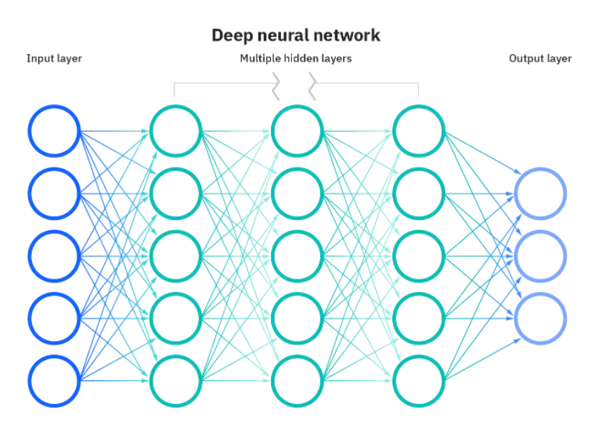
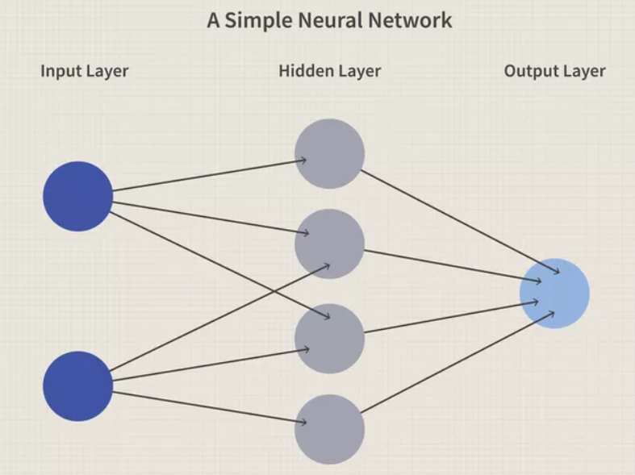
CNN MODEL
CONVOLUTION - It is a mathematical operation on two functions that produces a third that expresses how the shape of one is modified by the other.
NEURAL NETWORK - Neural networks are a series of algorithms that mimic the operations of an animal brain to recognize relationships between vast amounts of data.

Slide 11
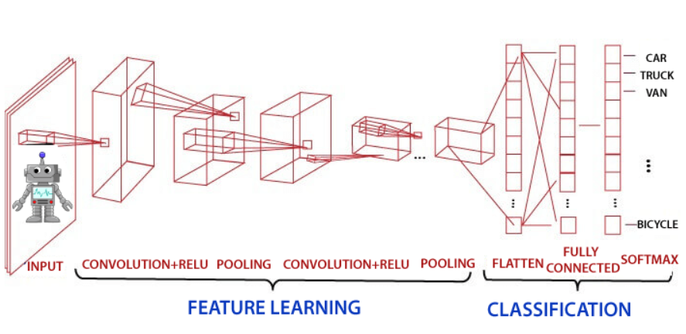
CNN MODEL

Slide 12
MODEL PARAMETERS
● Activation Function - ReLu, Softmax
● Epoch – 42
● Optimizer - Adam
● Hidden layers - 4
● Batch size -32

Slide 13
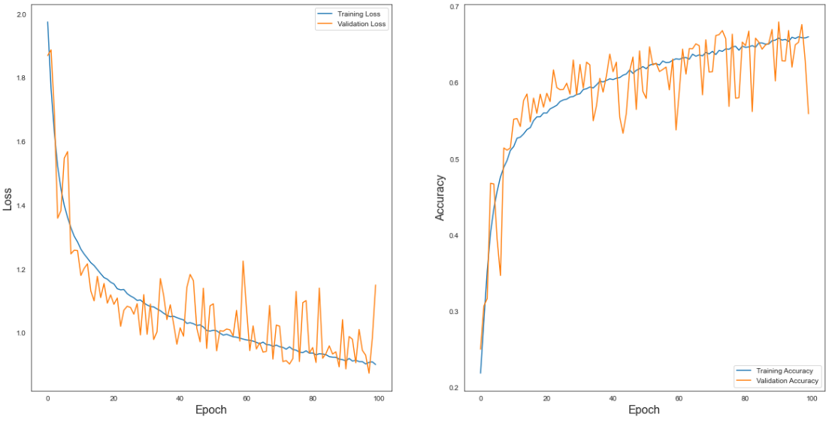
MODEL EVALUATION

Slide 14
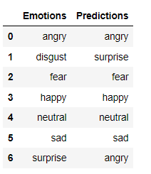
MODEL TEST
We got 5 out of 7 predictions correct on our test dataset.

Slide 15
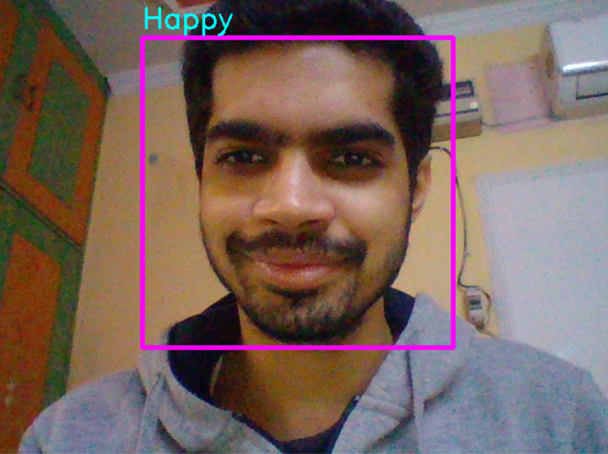
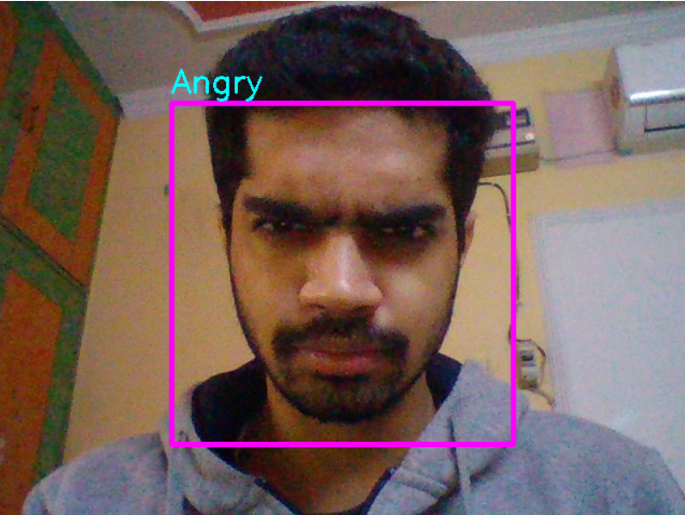
DEMONSTRATION

Slide 16
CHALLENGES
Low computational resources led to choosing a small dataset.
Experimentation was tough as a single iteration of model training took hours.
Overfitting occurred during the initial stages of the project.
Faced a lot of errors during deployment on Streamlit as a different set of codes are required.
Streamlit app is bit slow because of the usage of free account.

Slide 17
Conclusion
Learned about each and every process from EDA and development to deployment in project during the whole course.
Model is able to detect faces and classify facial emotions in real-time.
Model gave an accuracy of 67.3% on the validation set. (which can be increased with more computational resources and data).
Model has been deployed on Streamlit as end to end solution.
Model can be used on local machine in real time.

